Slide 2
DATA ALERT! (It caught your attention, didn’t it?)
#Data17
Gaetan Bailby
Systems Consultant
Tableau
Candy Wong
Product Manager – Data Driven Alerts
Tableau

Slide 3
Sujit Chaubal – Senior Software Engineer Jason Barile – Senior Software Engineer Evan McLain – Staff Software Engineer Jason Miller – Sales Consultant Jesse Sturges – Sales Consultant Jake Kinstler – Product Trainer
#Data17

Slide 4
Goals
Know what types of vizzes can and cannot be alerted on
Understand when alerts will check and when email will send
Use calculations to setup logic for alerts
Monitor Tableau Server to understand how to troubleshoot failing alerts

Slide 5
Agenda
Materials
Just the Basics (15 min)
The Zen of Alerts (50 min)
Break and Q&A (10 min)
Detecting & Addressing Alert Issues - IT (50 min)
Final Q&A (10 min)

Slide 6
MATERIALS

Slide 7
Materials
Find your user Login
[TBD: PLACEHOLDER]
Add your email address in Account Settings
Create a new project on Tableau Server

Slide 8
Just the Basics

Slide 9

“The last thing I need is another email, you know?”
Notes:
In short, people told us… they were drowning in data.
How many of you have felt like this poor guy?

Slide 10
Busy people need to make time to see their dashboard to know if their data is on track.
Dashboards often contain a mix data not all of which is personally relevant to every reader.
Notes:
Across all the customers we talked to, two themes kept recurring.

Slide 11
Follow Along (or don’t)
A demo of Data-Driven Alerts

Slide 12
The Zen of Alerts

Slide 13
The Power of Knowledge
If you can viz it, you can alert it!

Slide 14
The POWER of knowledge
If you can viz it, you can alert it!
You will learn how to:
Make tables alert-able
Alert on a customized view
Create alerts that only send during business hours
Create personalized alerts for others

Slide 15
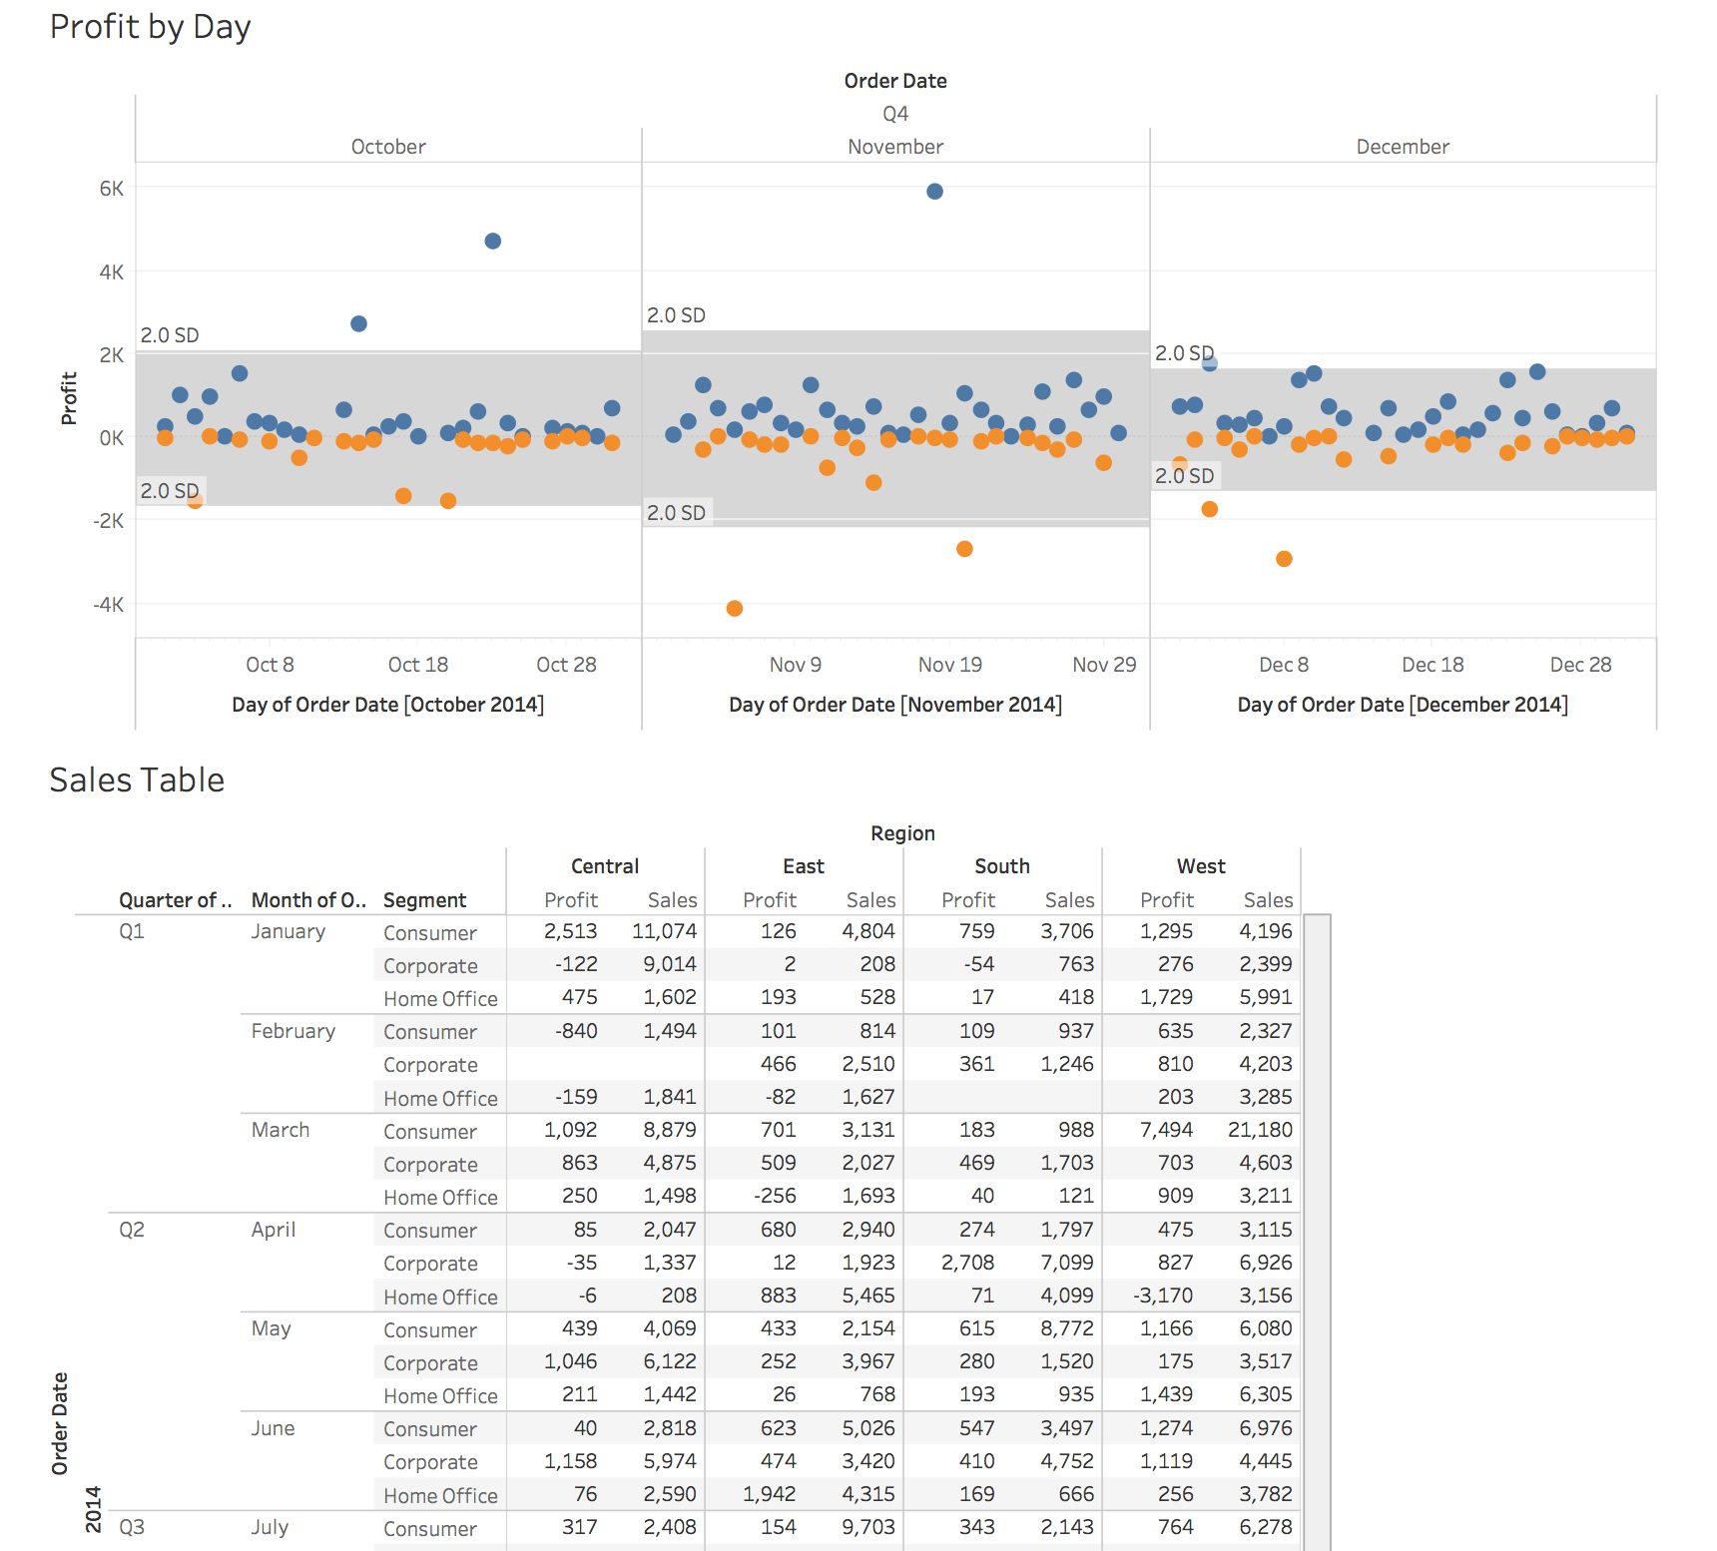
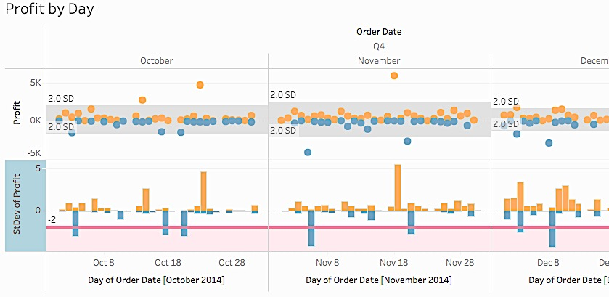
Does it Alert?! – Part 1
Challenge: Alert when the Profit by Day exceeds 2 standard deviation below the average of that month
Problem: No consistent axis for SD to alert on
Notes:
For each task, first pose the challenge to the class and give them a few minutes to try it themselves.
Then ask if anyone has the answer, and walk through the steps on stage.

Slide 16
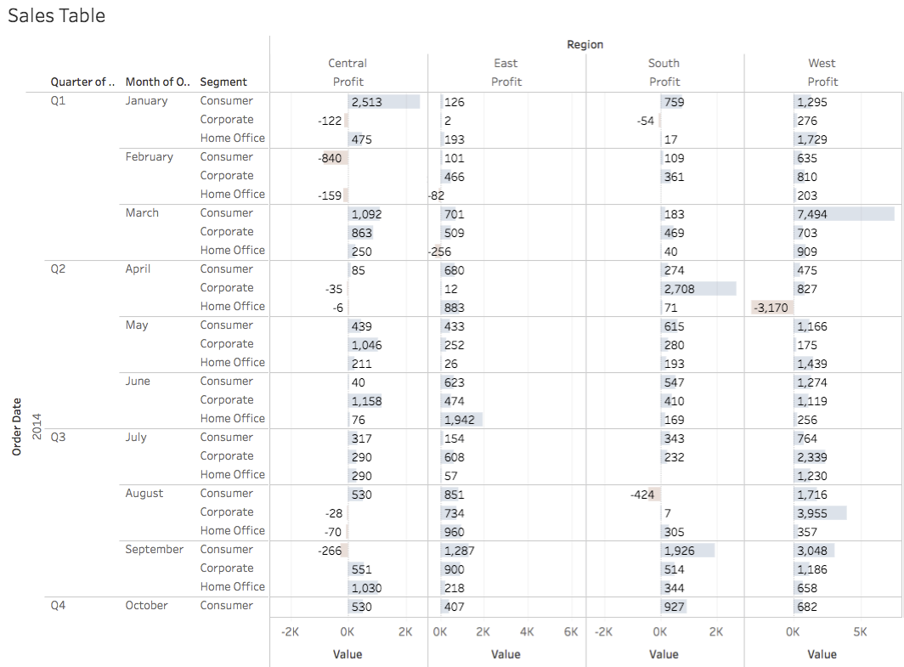
Does it Alert ?! – Part 2
3
Custom View to “Keep Only” for Profits
2
Table Formatting
1
Add a continuous axis
Challenge: Alert when the Profit drops below $1000 for any Segment or Regions
Problem: No numerical, continuous axis to alert on

Slide 17
Working this weekend?
Challenge: Alert for 3+ unprofitable orders in a given day and withhold all weekend alerts to be sent on the Monday after
Problem: No direct way to select sending on specific days

Slide 18

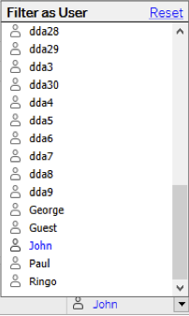
That Personal Touch
Challenge: Personalize the My Music dashboard so John, Paul, George, and Ringo get an alert if they’ve written more than 50% of any album.
Key Takeaway: Alerts respects user filters

Slide 19
Recap
If you can viz it, you can alert it
Alerts work the extra hours, so you don’t have to
Setting up Alerts on different types of vizzes
Using calculations to fine tune your alerts
User Filters are your friends

Slide 20
HALF TIME

Slide 21
Detecting & Addressing Alert Issues
Notes:
Preventing alert issues is extremely important. Your business may critically depend on flagging negative sales in a region, saving lives on detecting unusual seismic activity, or winning a NASCAR race by predicting engine component failures… You want to make sure these operation-critical alerts will always work.
The second part of this training will focus on understanding how alerts fail, how you can address those failures and finally how you can monitor all your alerts to optimise how they are configured and used.

Slide 22
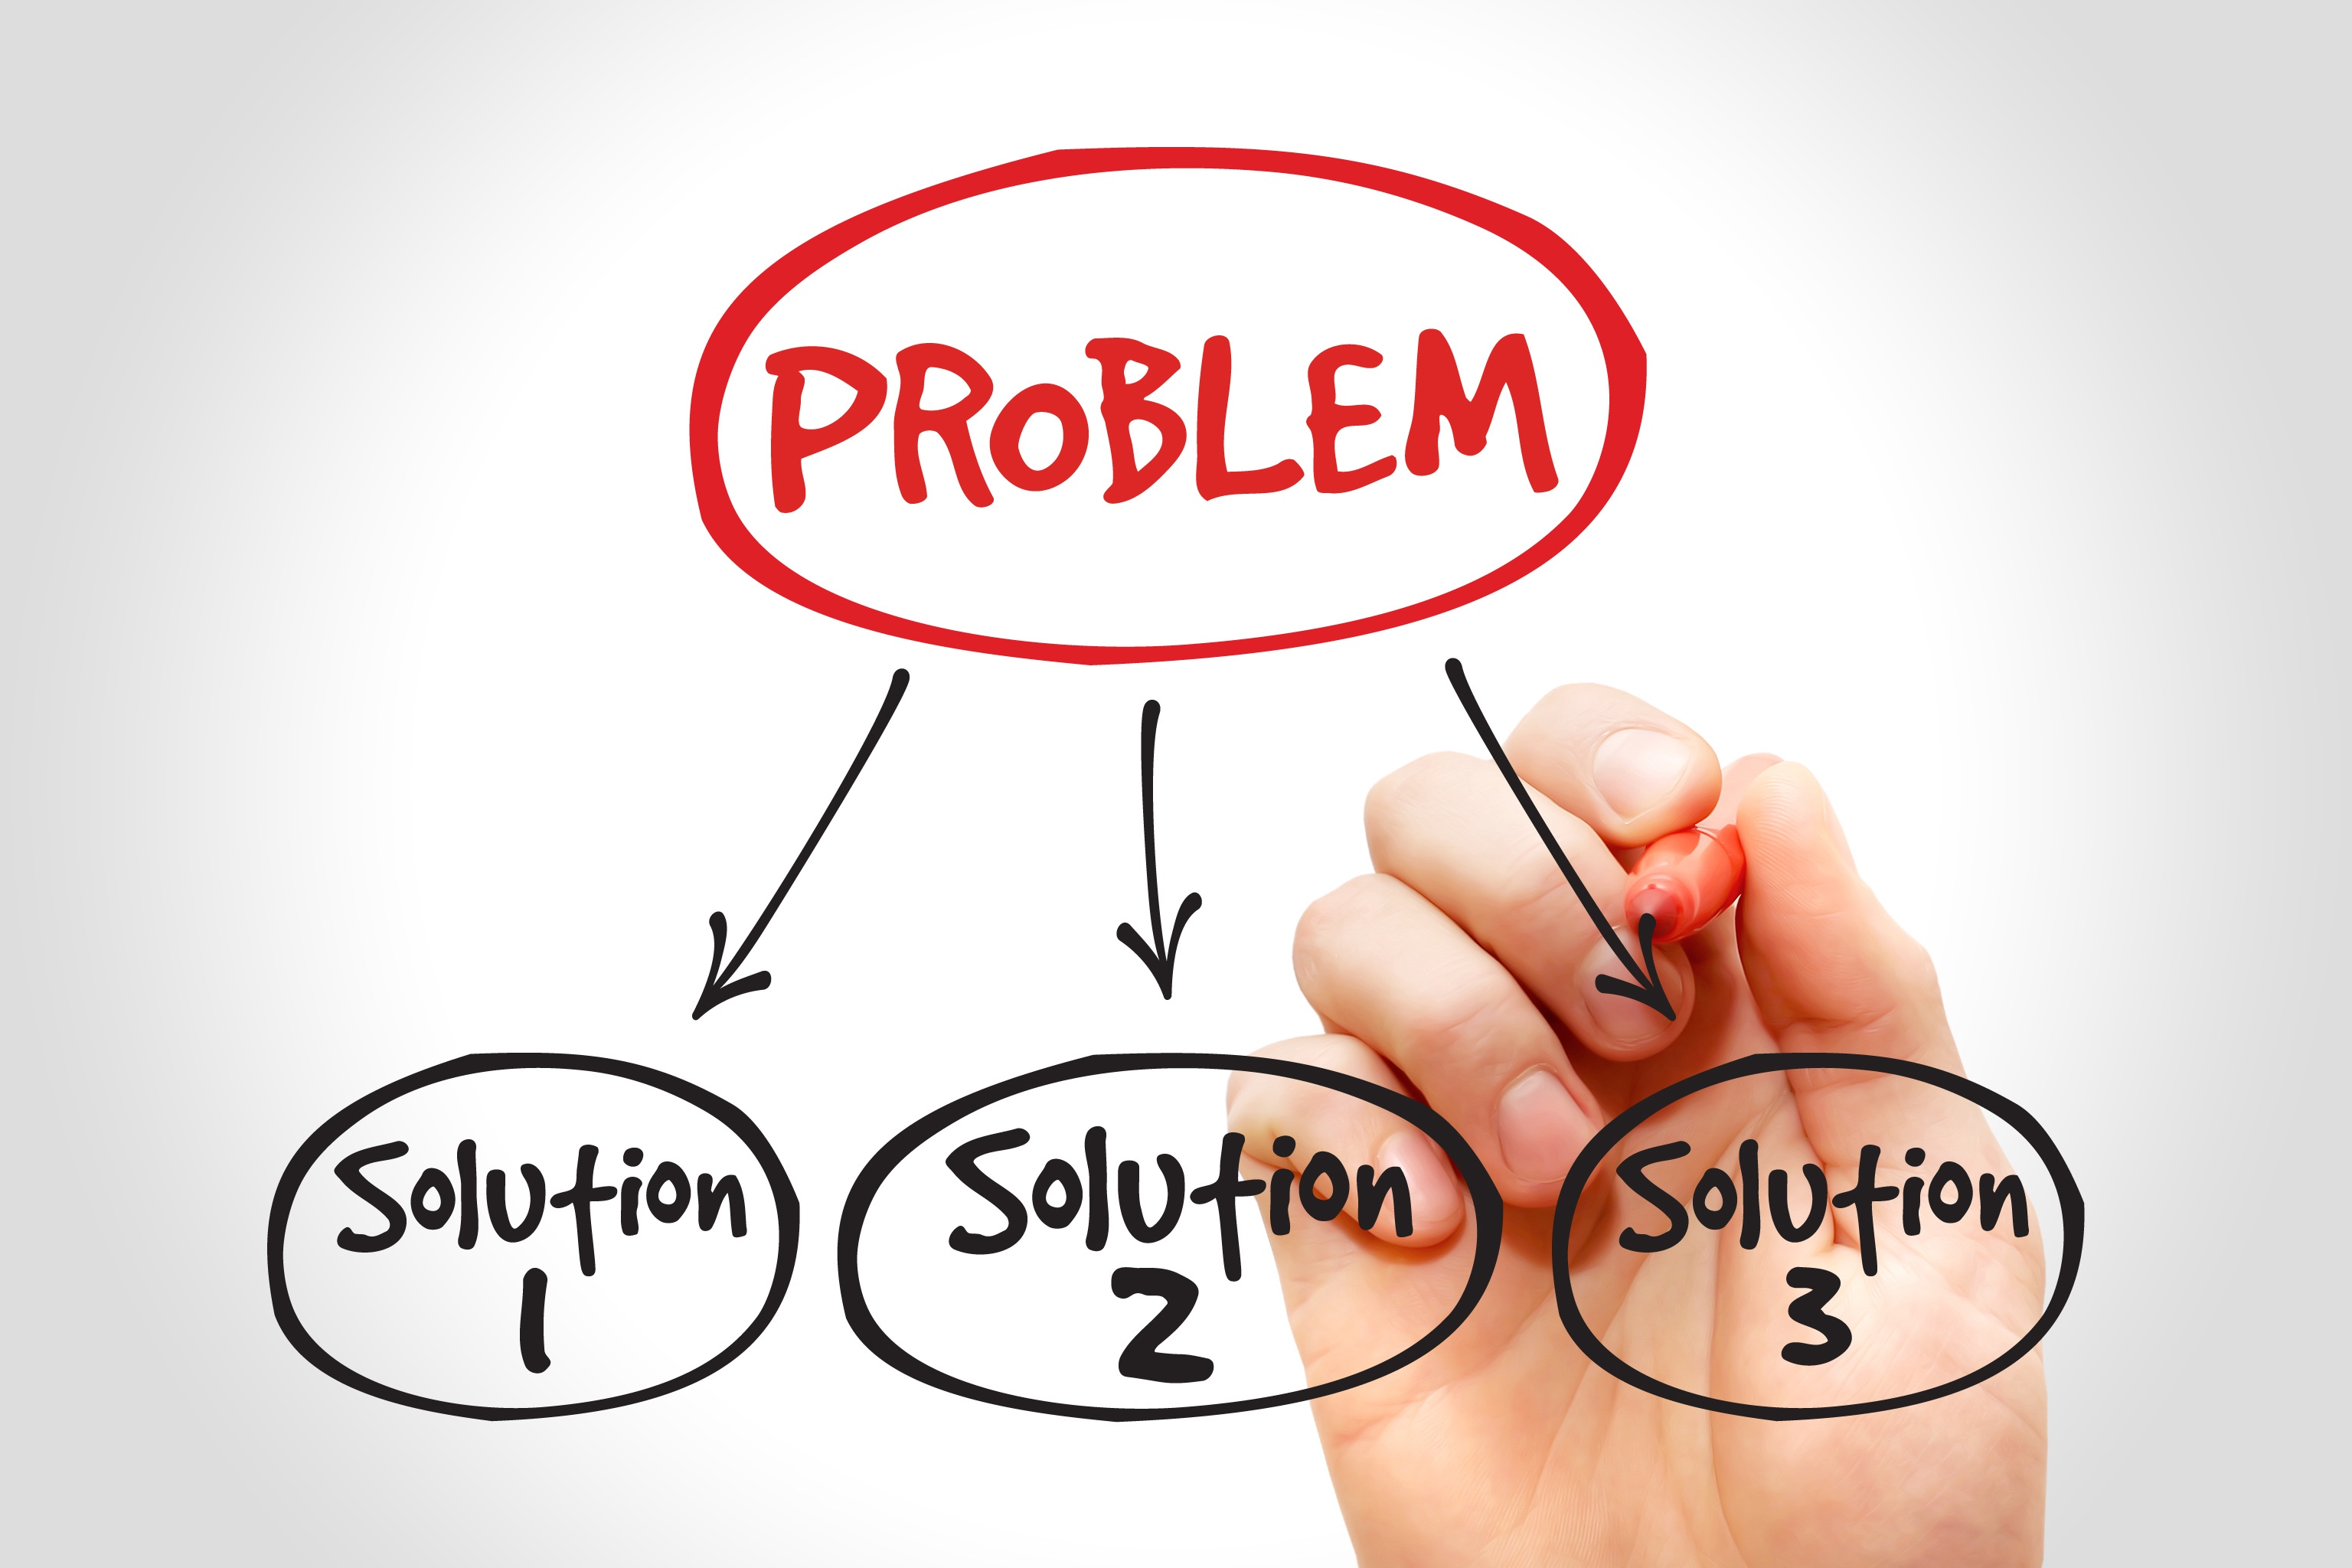
Types of Problems
Viz problems
Data Source problems
Long evaluation times

Slide 23
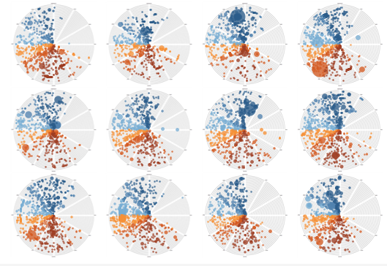
Viz Changed
Viz is updated after the alert is created, so the alert definition is no longer valid.
Workbook is recreated and re-published from scratch
Remedy
Delete and re-create the alert (DDA owner cannot edit the alert in these cases.)

Slide 24
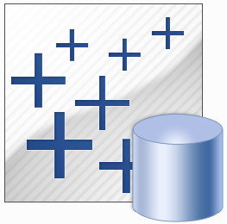
Data Source Errors
Database connection error
Connection refused
Invalid login credentials
Necessary drivers not installed
Network glitch
Database upgrades & patches
Query problems
Timeouts
Invalid or missing database column (db schema changed)

Slide 25

Long Evaluation Times
Entire viz pipeline is executed during DDA evaluation
For per-user alerts, the pipeline is run multiple times!
Remedies
Optimize the database query
Use an extract
Change the evaluation interval (default is 60 minutes) tabadmin dataAlerts.checkIntervalInMinutes
Add backgrounder worker processes

Slide 26
Failing alerts will repeat and are a waste of server resources

Slide 27

Load Management
Backgrounders
Server Architecture

Slide 28
What to know about Backgrounders
Single Threaded – This means the backgrounder process can only run one thread at a time, a thread being a set of executable instructions that a process can perform. The upshot of this is that your backgrounder works through a queue of tasks one-by-one.
Latency – Due to the single threaded nature of backgrounder, you may see delays or ‘latency’. For example, if you have one backgrounder, and 2 tasks for it to perform at 2am, then task 2 will have to wait until task 1 has finished. If task 1 takes an hour then task 2 won’t start until 3am. This can be annoying for users that expect their data to be refreshed by a certain time.
Resource Intensive – The backgrounder can consume a significant amount of processing power (CPU) and input / output (I/O) on your server. This is dependent on the type of task it is performing. It’s not uncommon to see a backgrounder node consuming 100% CPU.
Backgrounder affinity – In the latest version of Tableau Server, Backgrounders can now be assigned and dedicated to specific tasks.

Slide 29
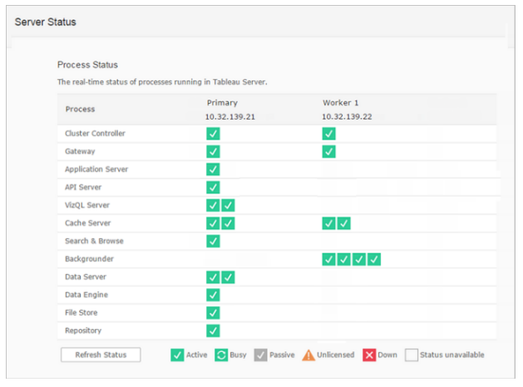
Server Architecture
N = number of cores on machine
Between N/2 and N/4 on a machine with other non-backgrounder processes
N on a backgrounder – only machine
Backgrounders are single threaded

Slide 30

Monitor Alerts
Tableau Server Status
Perfmon
Tabmon
Log analysis
PostgreSQL

Slide 31
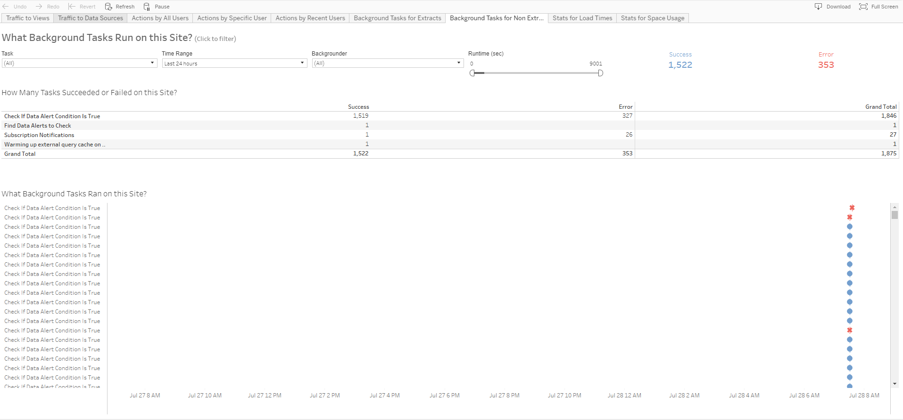
Admin Status Views

Slide 32
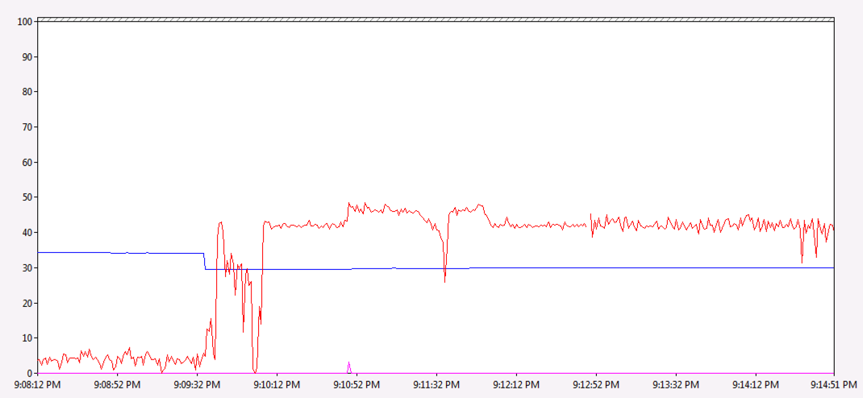
Perfmon
Perfmon is also available on all Windows machines
Perfmon allows you to record your choice of hundreds of system metrics
You can select the sampling frequency and recording duration to meet your needs
You can review and share the recordings with Tableau support
Notes:
Can be CPU usage, by process, Disk usage, or memory ustilization
In this example:
Red = CPU usage
Blue = Free memory
Magenta = Disk queue

Slide 33
Tabmon!
Utilizes Perfmon recording
The settings for which are still controllable by you
Adds information from JMX counters straight from Tableau Server
Get all the performance measurements from all of your workers in one place!
It is now open source!
You can download it here: https://github.com/tableau/TabMon
Notes:
Will sample system data from Perfmon and combine it with JMX counters generated by Tableau.

Slide 34
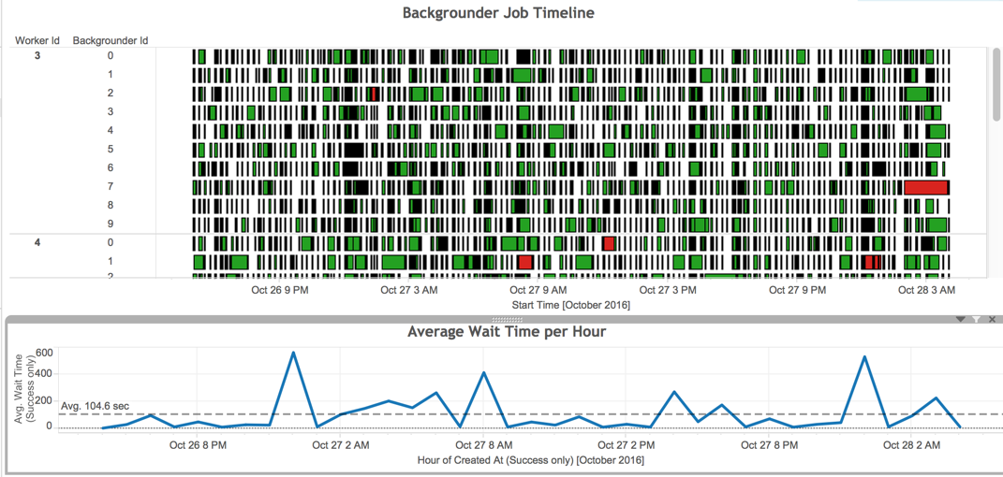
Log Analysis (Logshark)
Logshark is a powerful tool that allows you to go back and look at your servers logs to visualize what events have happened and look for patterns in usage https://github.com/tableau/Logshark
You can quickly look at the results to:
How long was each viz load on server
How busy have your backgrounders been and where might your bottlenecks be
How busy are VizQLs during extract refreshes?
Any bottlenecks with the Application Server?
Notes:
On top of Tabmon
Parses your logs and stores them in a Postgres table.

Slide 35
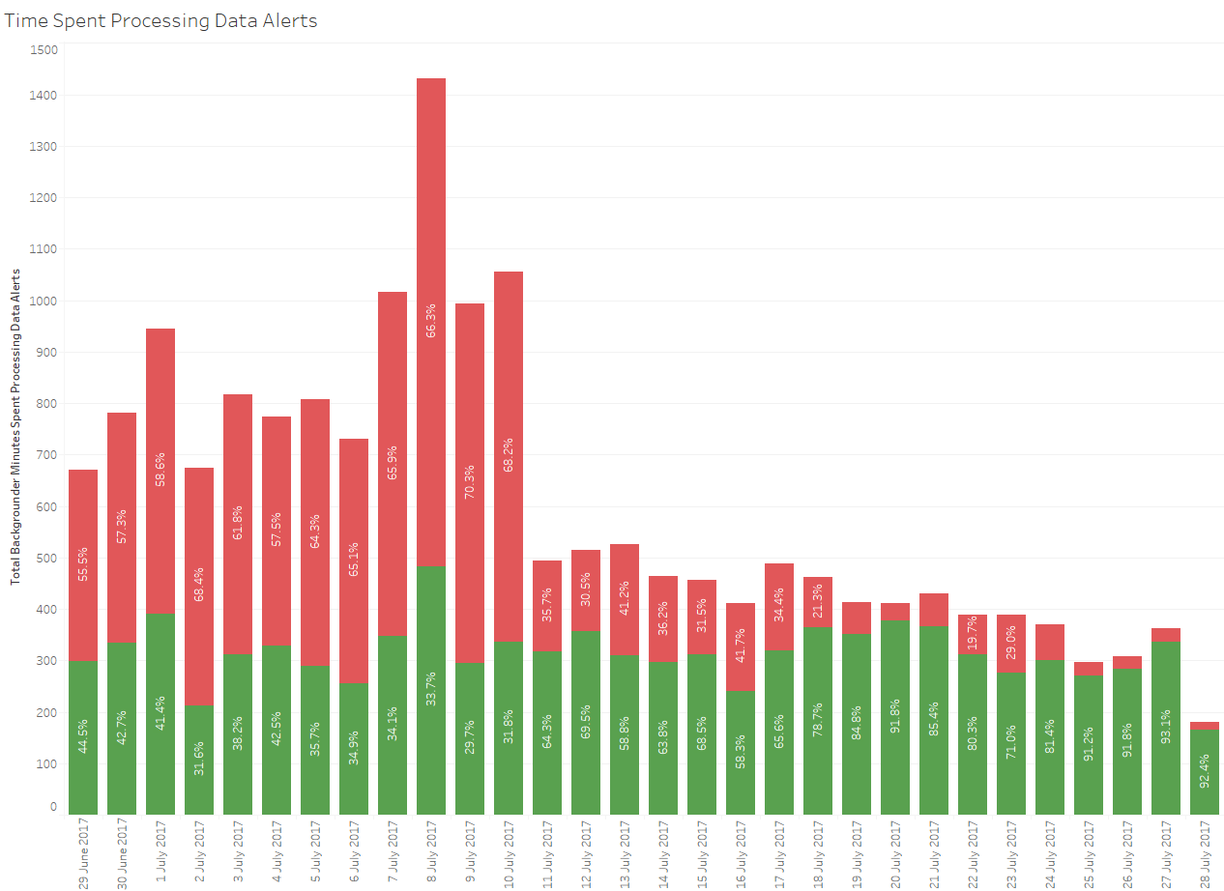
PostgreSQL
The Tableau Server repository is a PostgreSQL database that stores data about all user interactions, extract refreshes, and more.
Notes:
This is a point we identified there were several failing alerts….

Slide 36
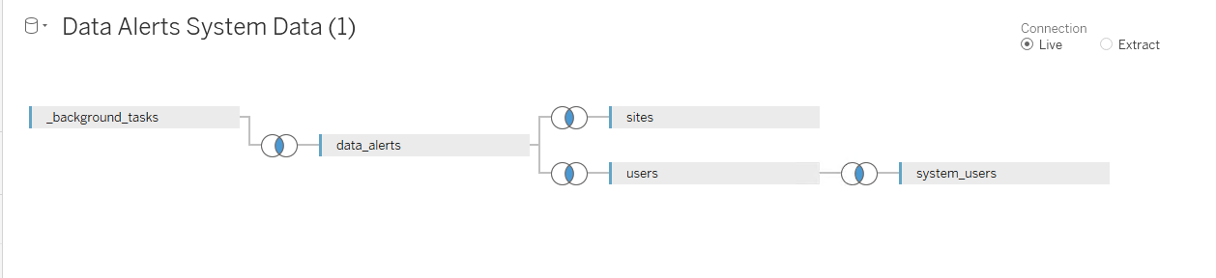
Where to find data alert data in PostgreSQL?

Slide 37
PRACTICE
Build views from Tableau’s PostgreSQL repository

Slide 38
Recap
Quickly troubleshoot failing alerts
Tweak your server configuration to optimise alerts
Set up advanced monitoring for your alerts

Slide 39
Final Thoughts
Feel free to take this content away with you
[Insert URL to Amazon S3 bucket]
Data Driven Alerts training videos and KB articles are available on our website https://www.tableau.com/learn

Slide 40
SESSION REPEATS
Tuesday, October 10 DATA ALERT! (It caught your attention, didn’t it?)
2:00pm - 4:30pm | South-L2-Lagoon H
Thursday, October 12 DATA ALERT! (It caught your attention, didn’t it?)
10:30am – 1:00pm | South-L2-Lagoon H

Slide 41
RELATED SESSIONS
Wednesday, October 11 High Alert! Mastering data-driven alerts
1:30pm– 2:30pm | North – South Pacific E
Thursday, October 12 Seamless Mobile Data Workflows
9:00am – 10:00am | South-L2-Surf C

Slide 42
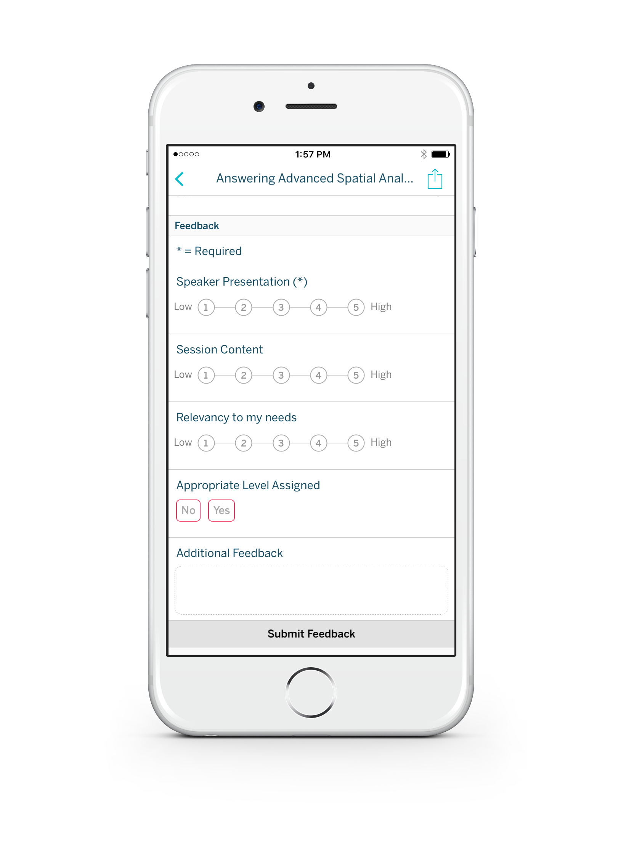
Please complete the session survey from the Session Details screen in your TC17 app

Slide 43

THANK YOU!

